Slide 1
Examination of Domestic Economic Impact of the US-China Trade War by Analyzing Stock Market Fluctuations with Unsupervised Machine Learning.
Xiangyang Meng
M.S. of Information Technology, School of Business and Technology
Mentor: Dr. Michelle Liu, School of Business and Technology

Slide 2
30 essential dates
June 28th, 2016 S&P 500: +1.78%
March 31th, 2017 S&P 500: -0.23%
April 7, 2017 S&P 500: -0.08%
July 19, 2017 S&P 500: +0.54%
Aug. 14, 2017 S&P 500: +1.00%
Jan. 17, 2018 S&P 500: +0.94%
Jan. 22, 2018 S&P 500: +0.81%
March 8, 2018 S&P 500: +0.45%
April 2, 2018 S&P 500: -2.23%
April 3, 2018 S&P 500: +1.26%
April 4, 2018 S&P 500: +1.16%
June 15, 2018 S&P 500: -0.10%
July 10, 2018 S&P 500: +0.35%
Aug. 1, 2018 S&P 500: -0.10%
Aug. 7, 2018 S&P 500: +0.28%
Aug. 23, 2018 S&P 500: -0.17%
Sept. 7, 2018 S&P 500: -0.22%
Sept. 24, 2018 S&P 500: -0.35%
Dec. 1, 2018 S&P 500: +1.09%
Feb. 24, 2019 S&P 500: +0.12%
May 5, 2019 S&P 500: -0.45%
May 8, 2019 S&P 500: -0.16%
June 18, 2019 S&P 500: +0.97%
June 29, 2019 S&P 500: +0.77%
Aug. 1, 2019 S&P 500: -0.90%
Aug. 13, 2019 S&P500: +1.5%
Aug. 23, 2019 S&P 500: -0.1%
Sept. 20, 2019 S&P 500: -0.53%
Sept. 23, 2019 S&P 500: -0.01%
Oct. 7, 2019 S&P 500: -0.46%

Slide 3
Discipline-appropriate methods used
3 major phases
Data collection and cleaning
Training data through unsupervised machine learning
Analyzing clusters and trend

Slide 4
Data collection and cleaning
Collected historical stock data through Alpha Vantage API
2555 NYSE stocks + 2524 NASDAQ stocks
Sorted out stocks registered before June 28, 2016 and closed after October 7, 2019

Slide 5
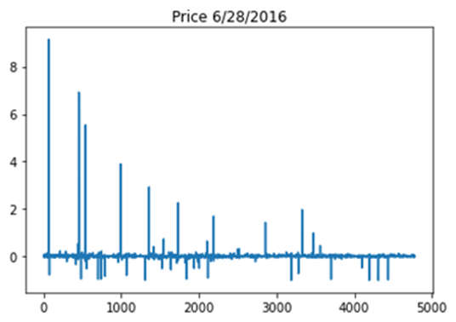
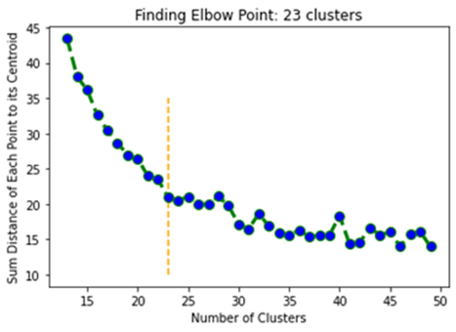
Training data through unsupervised machine learning
Used K-Means Algorithm and Elbow method to do unsupervised machine learning
Unsupervised machine learning on each essential date

Slide 6
Clustering result on each essential date
No | Date | S&P 500 | Result: Number of Large Clusters (>100 stocks)
1 | 6/28/2016 | +1.78% | 9
2 | 3/31/2017 | -0.23% | 6
3 | 4/7/2017 | -0.08% | 5
4 | 7/19/2017 | +0.54% | 9
5 | 8/14/2017 | +1.00% | 8
6 | 1/17/2018 | +0.94% | 9
7 | 1/22/2018 | +0.81% | 8
8 | 3/8/2018 | +0.45% | 9
9 | 4/2/2018 | -2.23% | 9
10 | 4/3/2018 | +1.26% | 10
11 | 4/4/2018 | +1.16% | 9
12 | 6/15/2018 | -0.10% | 10
13 | 7/10/2018 | +0.35% | 4
14 | 8/1/2018 | -0.10% | 10
15 | 8/7/2018 | +0.28% | 9
16 | 8/23/2018 | -0.17% | 9
17 | 9/7/2018 | -0.22% | 11
18 | 9/24/2018 | -0.35% | 10
19 | 12/1/2018 | +1.09% | 13
20 | 2/24/2019 | +0.12% | 11
21 | 5/5/2019 | -0.45% | 7
22 | 5/8/2019 | -0.16% | 12
23 | 6/18/2019 | +0.97% | 12
24 | 6/29/2019 | +0.77% | 10
25 | 8/1/2019 | -0.90% | 10
26 | 8/13/2019 | +1.5% | 7
27 | 8/23/2019 | -0.1% | 8
28 | 9/20/2019 | -0.53% | 15
29 | 9/23/2019 | -0.01% | 14
30 | 10/7/2019 | -0.46% | 12
The clustering result is similar to the industry classification of the stock market

Slide 7
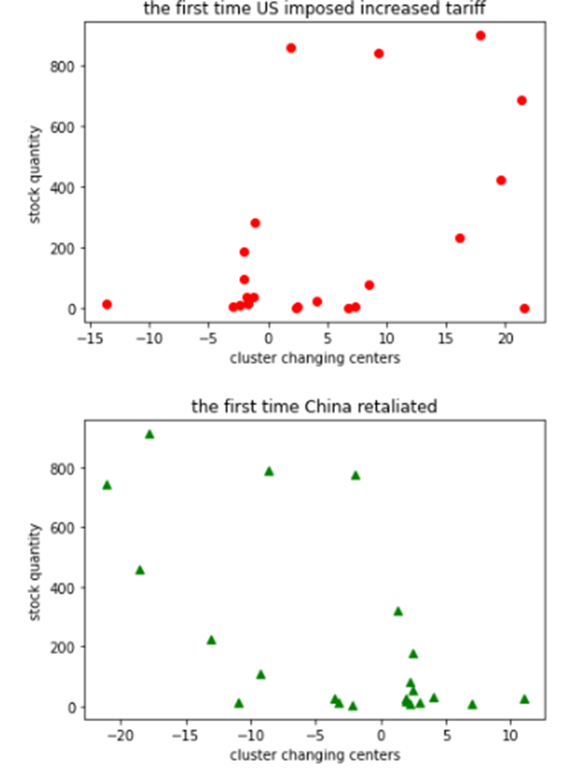
Relationship between the price fluctuation of each cluster and the number of stocks of each cluster
When the U.S. firstly planned to counter unfair trade from China on June 28, 2016, more stock prices were increasing. There are more clusters of rising stocks. This pattern indicates that people had the confidence for US winning the Trade War.
When China retaliated the first time on April 2, 2018, more stock prices were decreasing, showing that people were optimistic about China and Chinese manufacturers. There are more clusters of decreasing stocks. The pattern is that the more the cluster decreased, the more stocks in the cluster.

Slide 8
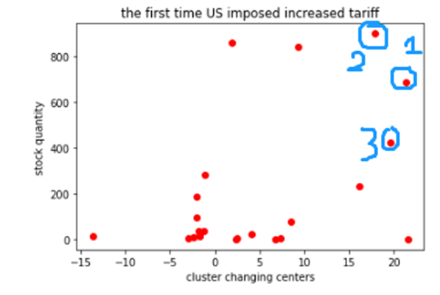
Analyzing the three most positively influenced clusters when the U.S. decided to slap trade war against China on June 28, 2016

Slide 9
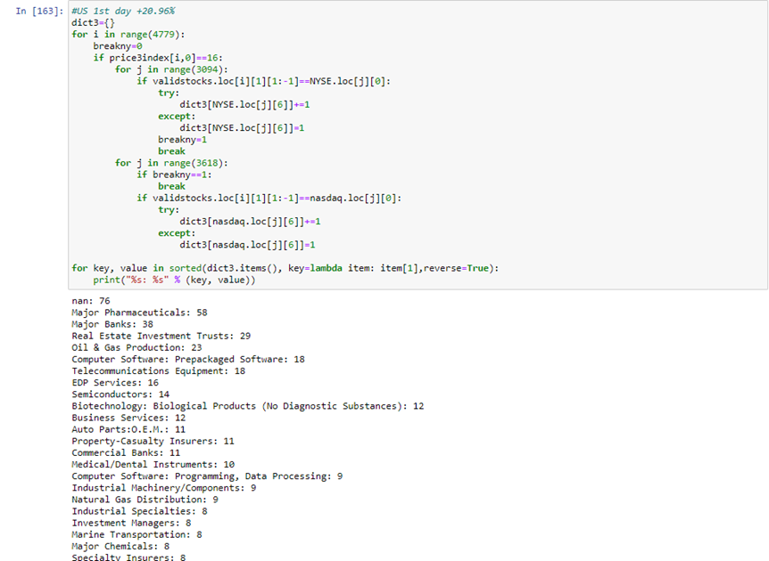
1st cluster
The top four industries :
major pharmaceuticals (58)
major banks (38)
Real estate investment (29)
oil & gas (23)

Slide 10
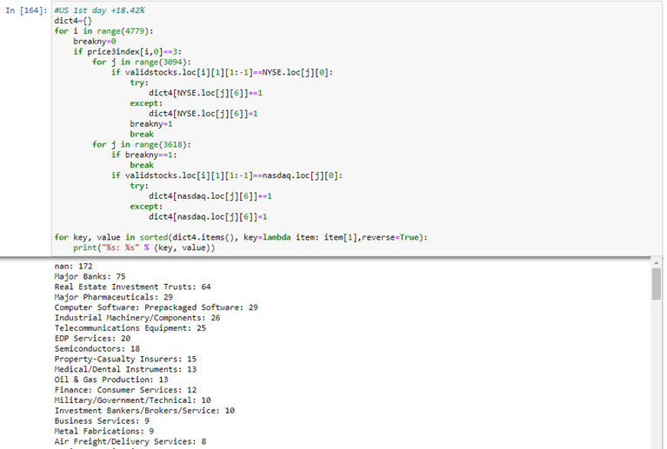
2nd cluster
The top four industries:
Major Banks (75)
Real estate Investment (64)
Major Pharmaceuticals (29)
Computer Software(29)

Slide 11
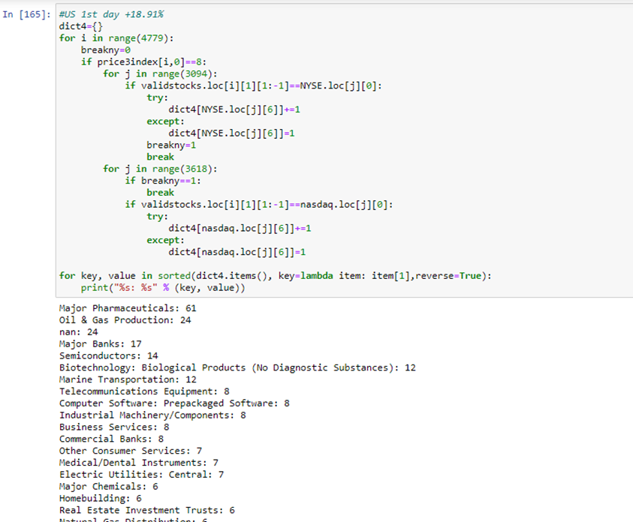
3rd cluster
The top four industries:
Major Pharmaceuticals (61)
Oil & Gas (24)
Major Banks (17)
Semiconductor (14)

Slide 12
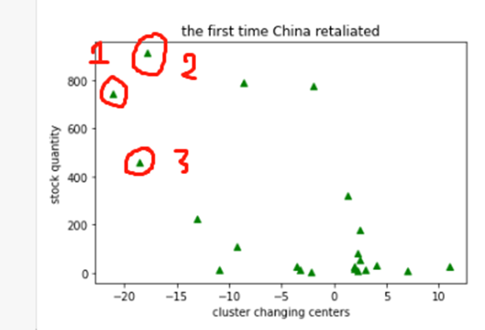
Analyzing the three most negatively influenced clusters when China retaliated on April 2, 2018

Slide 13
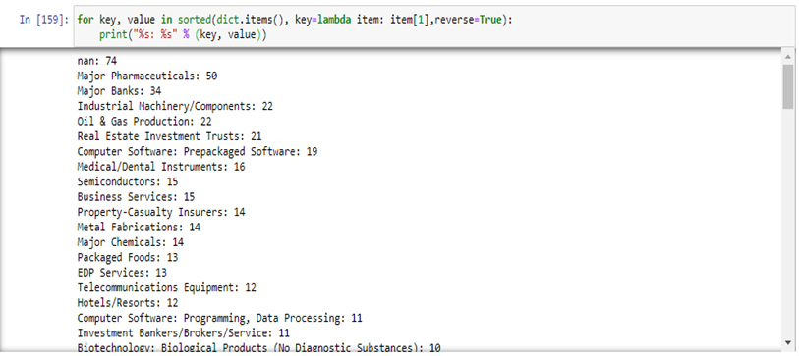
1st cluster
The top four industries :
major pharmaceuticals (50)
major banks (34)
industrial machinery/components (22)
oil & gas (22).

Slide 14
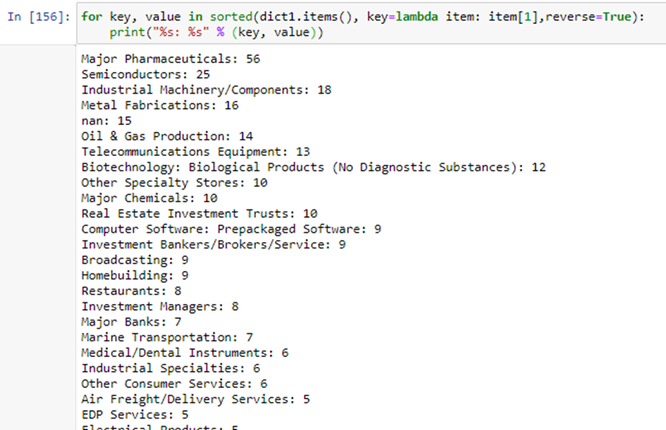
2nd cluster
The top four industries:
Major pharmaceutical (56)
Semiconductor (25)
industrial machinery (18)
Metal Fabrication (16)

Slide 15
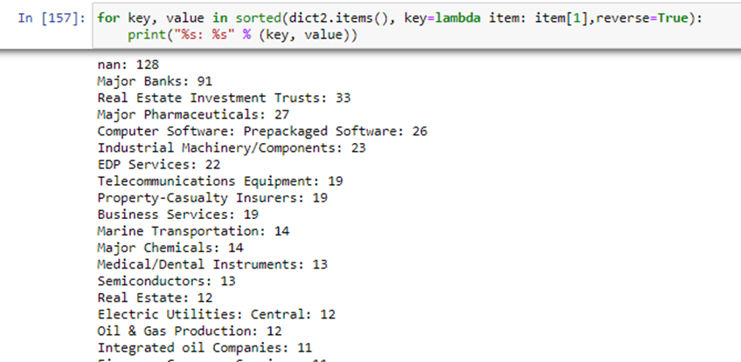
3rd cluster
The top four industries:
Major Banks (91)
Real Estate Investment (33)
Major Pharmaceuticals (26)
Computer Software (26)

Slide 16
Top positively influenced industries on June 28, 2016
Top negatively influenced industries on April 2, 2016
major pharmaceuticals
oil & gas
major banks
real estate investment
Semiconductor
Computer software
major pharmaceuticals
oil & gas
major banks
real estate investment
Semiconductor
Computer software
Metal Fabrication

Slide 17
Summary of findings/outcomes/creative work.
Research findings:
clustered the stocks based on performance
research results demonstrate that people had higher expectations for the U.S. economy when the trade war first started. In contrast, people had lower expectations for the Chinese economy and manufactures when China retaliated for the first time.
finds out at the beginning of the trade war the most influenced industries are major pharmaceuticals, industrial machinery and components, oil & gas, major banks, real estate investment, and semiconductor.
Creative work:
combines the I.T. and business fields and brings computer-based scientific methods into the analysis of the stock market.
demonstrates how to use the unsupervised machine learning tool to analyze government policies' impacts on the stock market

